Slide 1
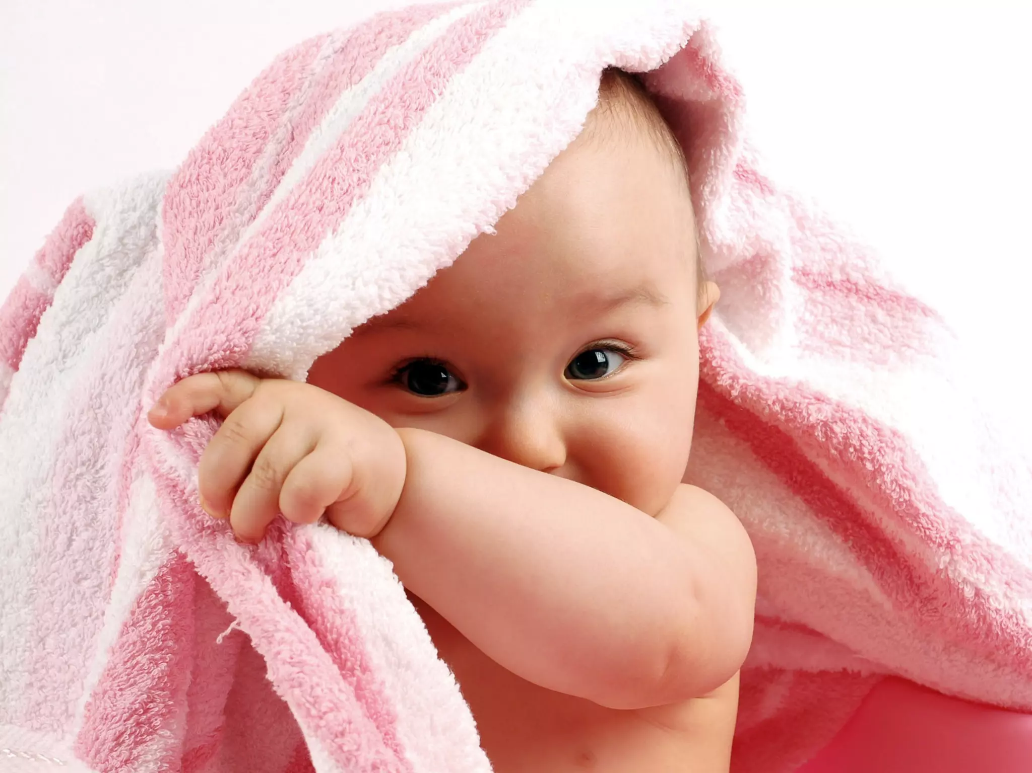
ANALYSIS OF TOP BABY NAMES IN U.S.
DATA SCIENCE LAB-1
INSTRUCTOR :DR. DOOTIKA VATS

Slide 2
Data Collection-
Data was obtained from ssa.gov website.
Information regarding top 100 baby names of each decade were scraped from a list of top 200.
Problems faced-
The number of babies had commas as separators , which was removed for convenience.
The decade-wise data had to be accessed through different links and consolidated into one table.

Slide 3
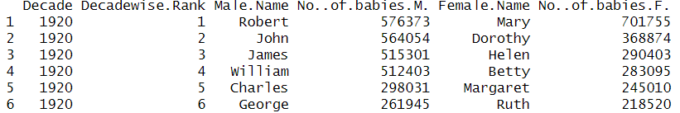
About the dataset-
The dataset contains information regarding top 100 most popular male and female names of each decade, from 1920 to 2010.
It consists of 1000 rows and 6 columns.
Variable | Description
Decade | It shows the decade considered.
Decadewise. Rank | It shows the rank of the names appearing in the column in that particular decade.
Male.Name | It shows the male name corresponding to the particular rank.
No..of. Babies.M. | It shows the no. of babies with the corresponding male name.
Female.Name | It shows the female name corresponding to the particular rank.
No..of.babies.F. | It shows the no. of babies with the corresponding female name.

Slide 4
Interesting questions regarding the dataset-
How has the popularity, i.e, the rank and no. of babies with the top-ranked names changed over the decades?
Is the change in popularity similar between the top-ranked male and female names?
How does the popularity of names vary with choice of initial letter and which letters have been consistently popular?
How does the popularity of names differ with different length of name for both male and female names?
Which names have appeared in top rankings of both males and females?

Slide 5
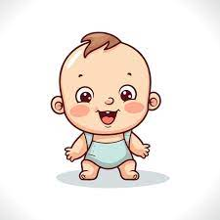
NOW …
VISUALIZATIONS!

Slide 6
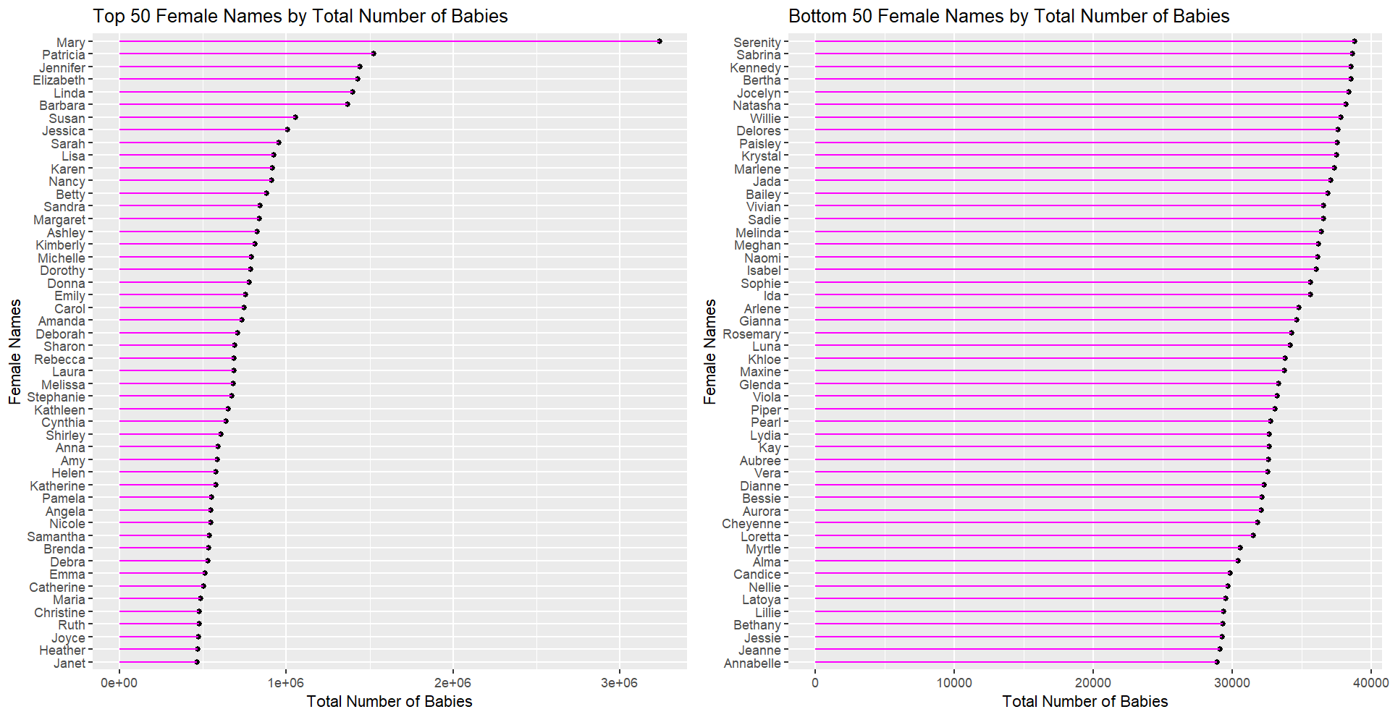
The most popular female name is Mary, followed by Patricia and Jennifer.
Annabelle seems to be the least popular female name in the list, having less than 30000 total babies.
The bottom names have very less babies compared to top, which may be explained by the fact that they possibly appear in very few decades.

Slide 7
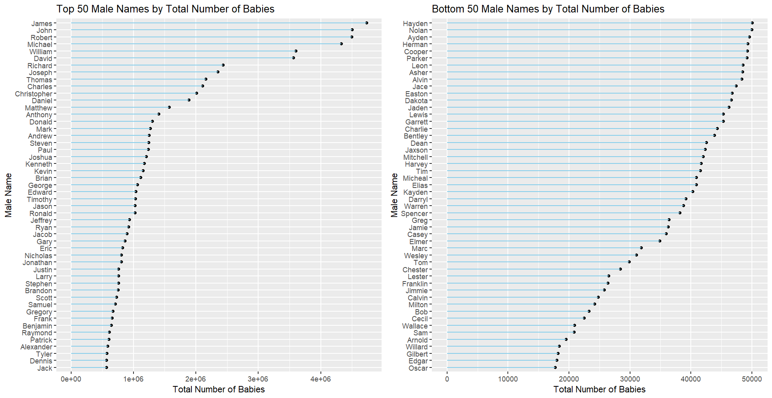
The most popular male name is James, followed by John. (Both start with ‘J’!)
There are occasional drops in total number of names.
Oscar, Edgar and Gilbert seem to be the least popular names,having less than 20000 babies in the list.

Slide 8
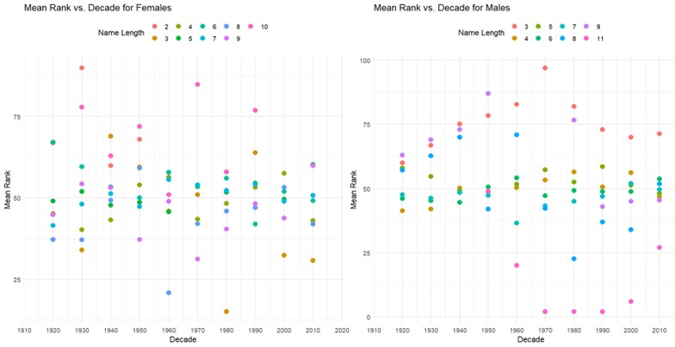
PLOT OF MEAN RANK VS DECADE FOR VARYING LENGTH OF NAMES
The female names with 5,6,7 and 9 letters have been consistently moderately popular.
3 letter names look like they have been very popular recently , possibly due to a specific name(“Ava”).
10 letter names have been consistently less popular.
Male names with 5,6 and 7 letters have been moderately popular.
3 letter names saw a drop in popularity but regained it to an extent after 1970.
11 letter names look like they have been very popular recently, due to the name “Christopher” which has been the most popular name in 1970,1980 and 1990.

Slide 9
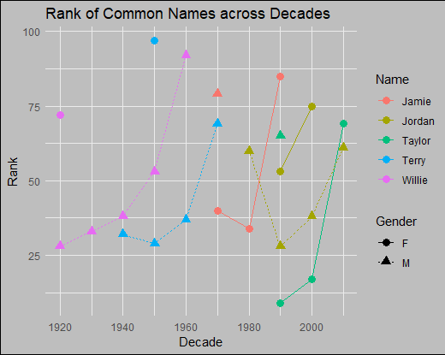
Jamie
Jordan
Taylor
Terry
Willie
What do these names have in common? Well, they are common!
The names have been popular at similar times for either gender.
Among common names, only Taylor has reached the very top ranks among females.
The others have been moderately or less popular among top ranks.
Some of these names have been significantly more popular among males ,
some among females.

Slide 10
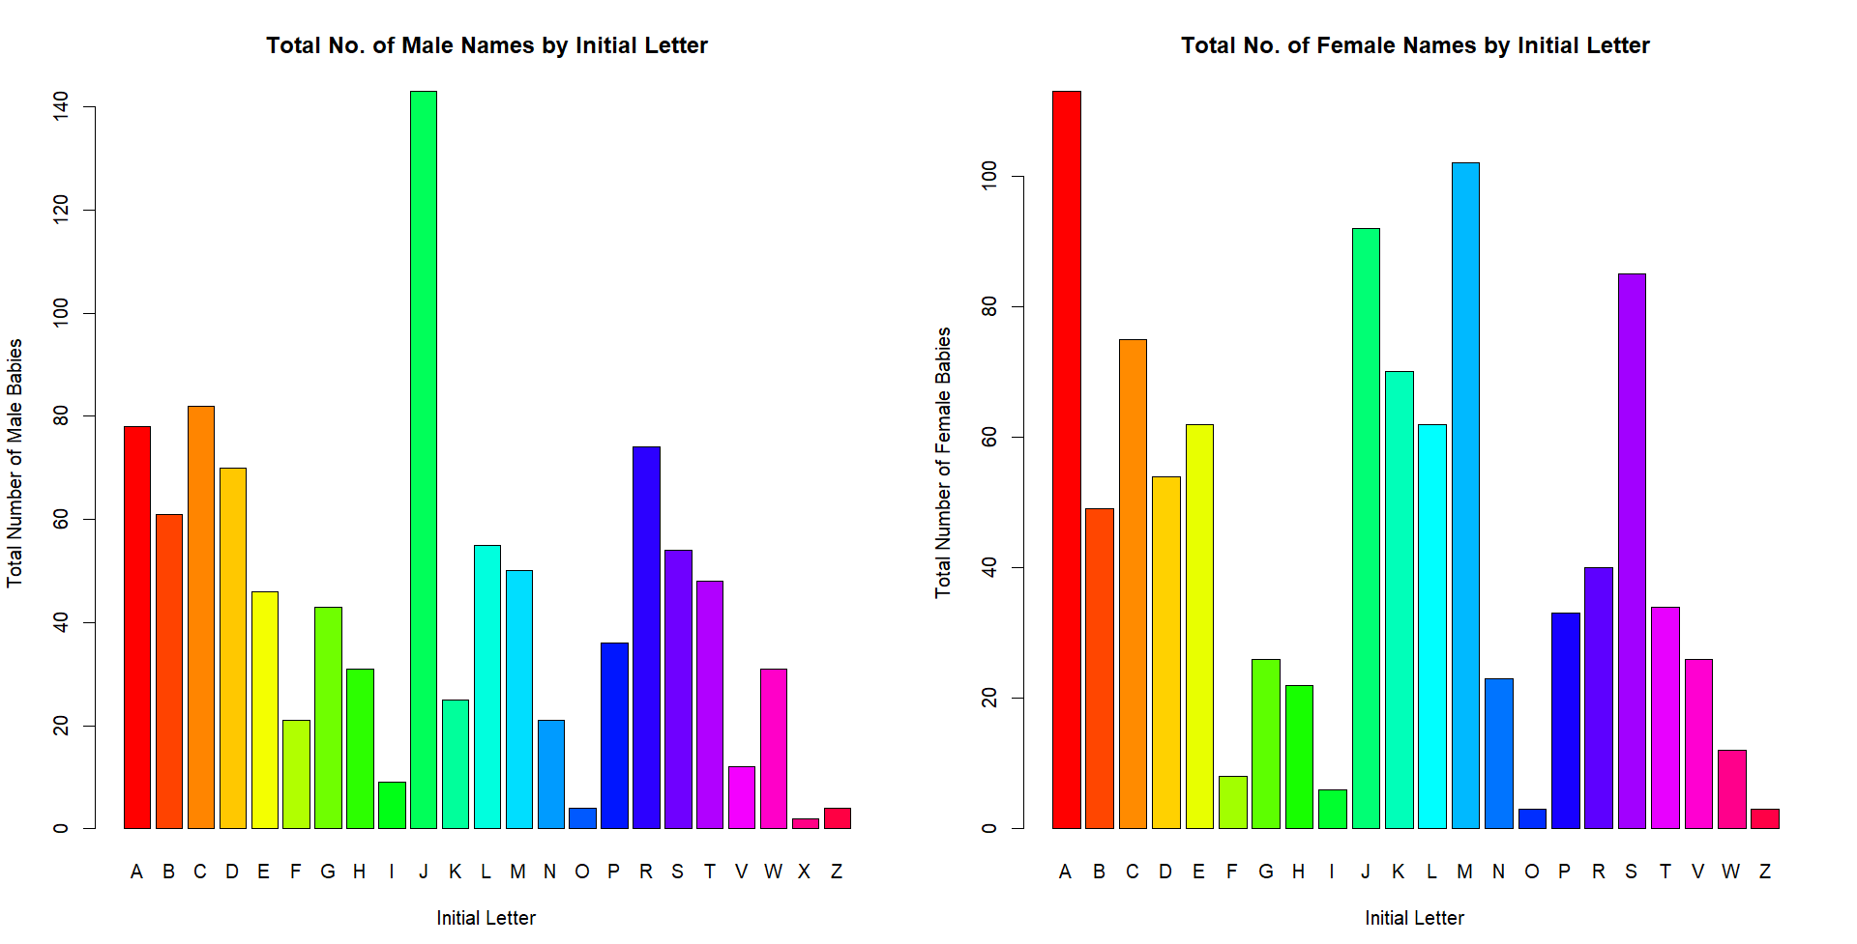
J is the most popular initial for male names(in terms of variety of names) by far, followed by C, A and R. X,Z and O are the least popular.
A is the most popular initial for females, followed by M and J. O and Z are the least popular , and X has not even appeared in the ranks.

Slide 11
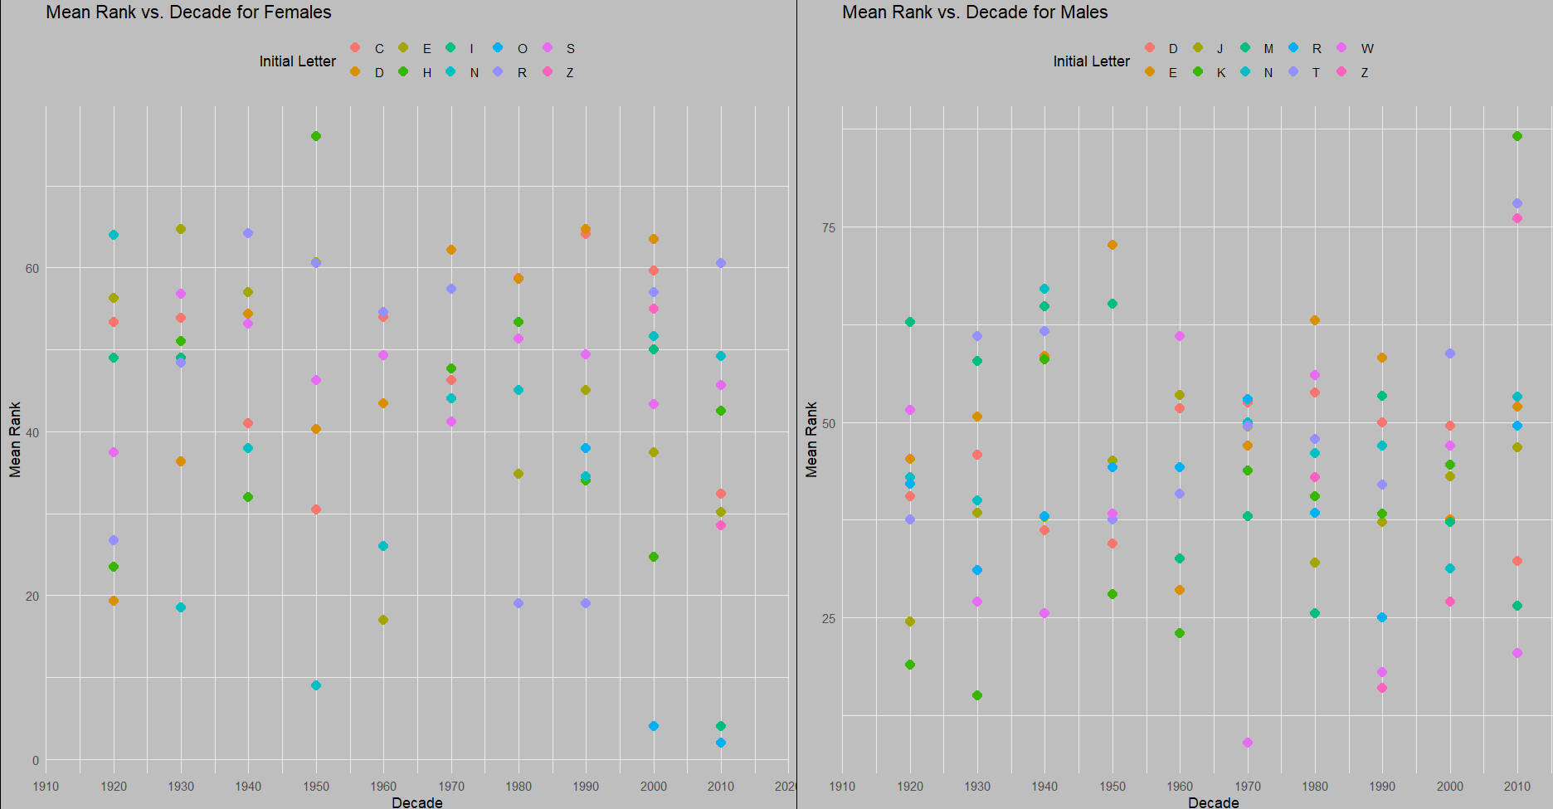
PLOT OF MEAN RANK VS DECADE FOR TOP 10 INITIAL LETTERS
N has been a popular initial among females recently.
S,D and R have been consistently moderately popular.
Z has been popular for only 1 decade.
W has been very popular recently, probably due to “William”.
K was popular in the past,but has fallen in ranks now.
J, D and M have been consistently moderately popular.

Slide 12
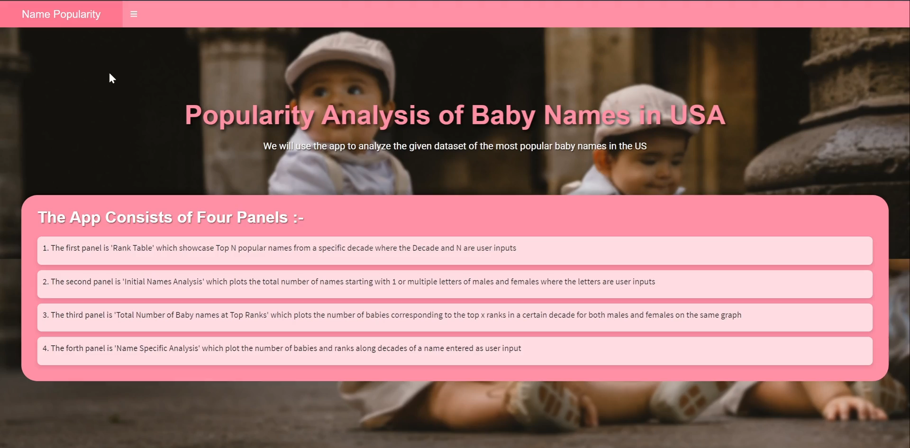
R SHINY APP

Slide 13
Insights regarding the dataset-
Mary is the most popular female name, James and John are the most popular male names. (All of biblical origin!)
Names with moderate length are consistently moderately popular, while particular short and long names have been very popular for females and males, respectively.
J has been the most popular initial for males , and has been quite popular for females as well.
Females seem to have more variety in popular initials.
The choice of initial letter has varied quite much with time for both males and females with only a few letters being consistently popular.
There have been five popular names which are common between both genders, but they have mostly been moderately popular.

Slide 14
Thank You!
Group -20
Sujash Krishna Basak Tathagata Banerjee Ketan Saini
Anjali Gond

